Slide 1
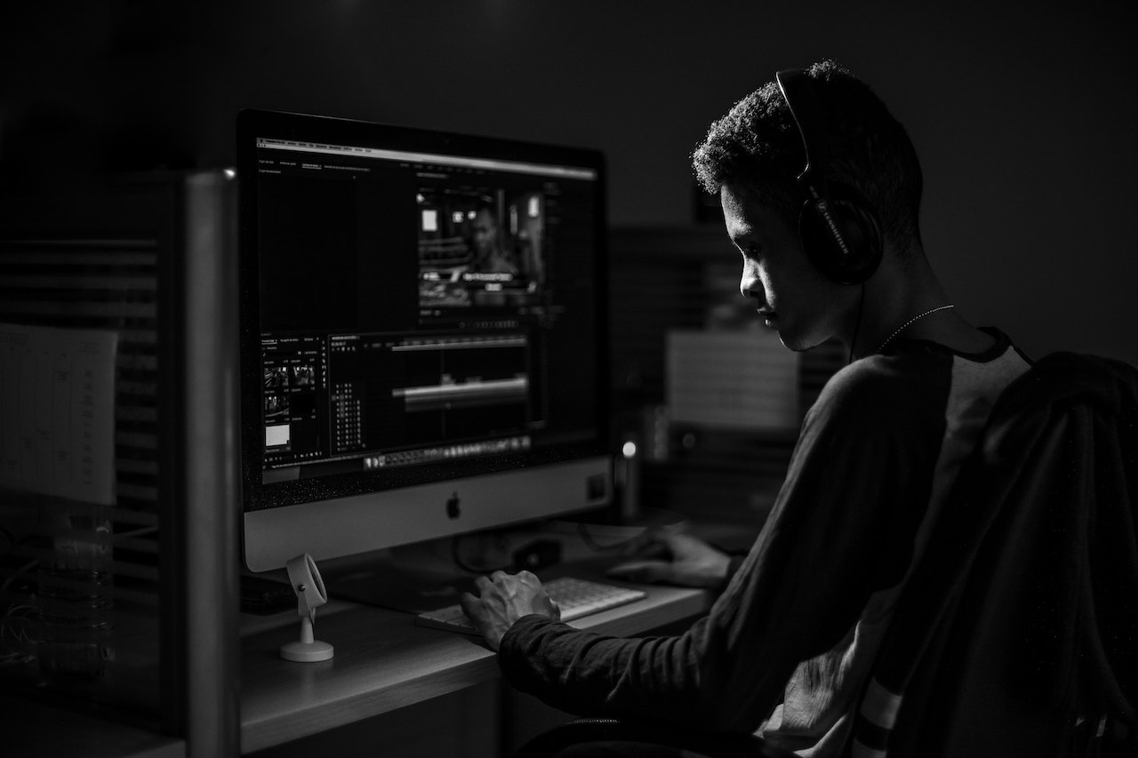


STRESS MONITORING AND RELIVING APPLICATION FOR IT PROFESSIONALS
TMP_2023_139

Slide 2

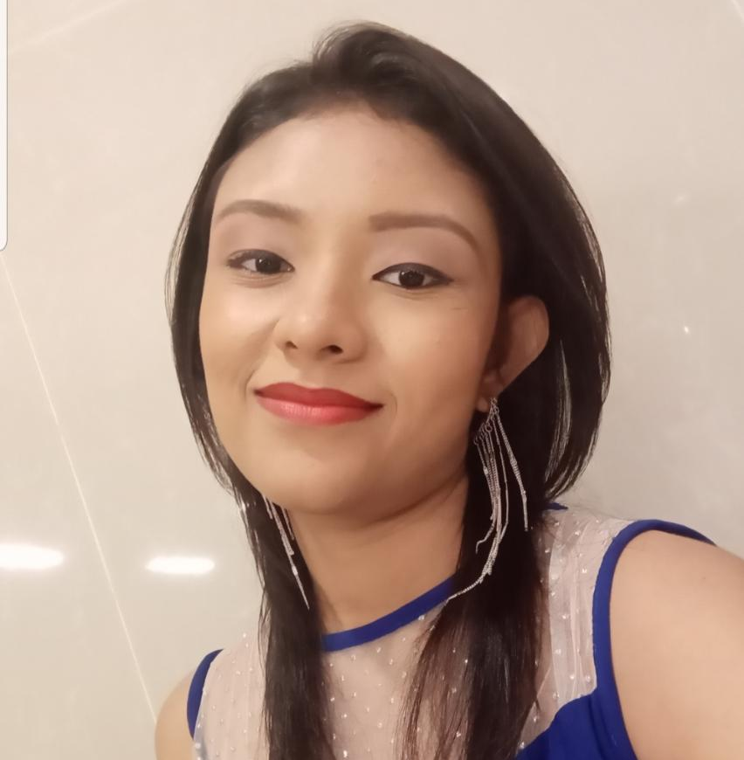
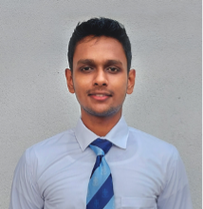
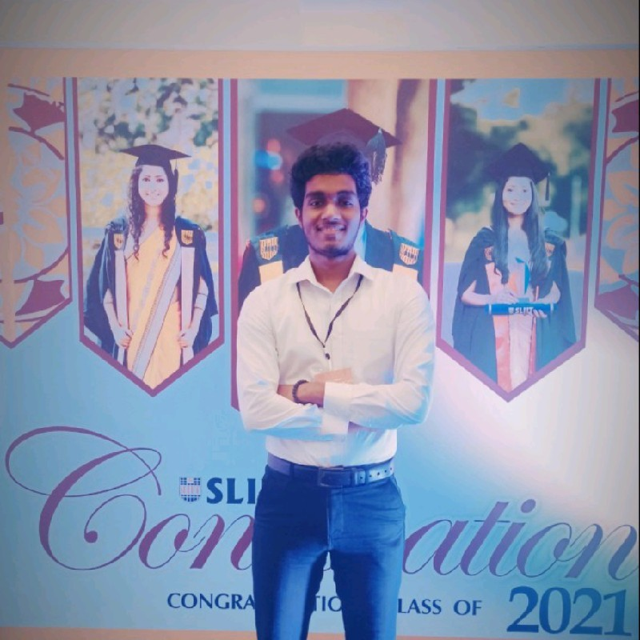
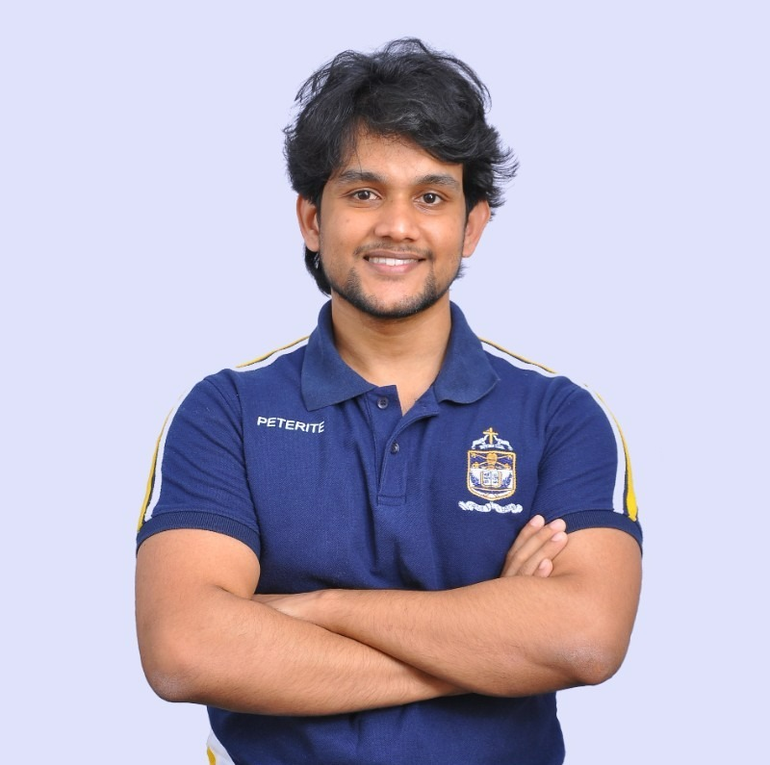

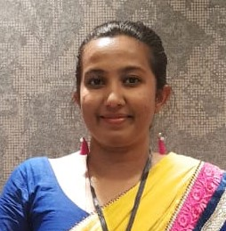
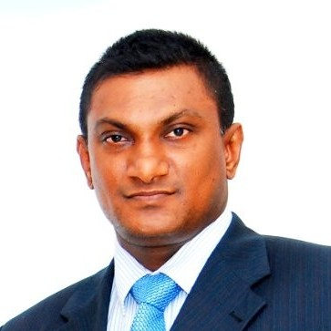
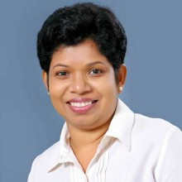
TEAM
Ranasinghe J. D
IT20037888
Perera M. S. D
IT20020262
Jayathilake S. M. D. A. R.
IT20037338
Bartholomeusz S. V.
IT20274702
Mr. Samadhi Rathnayake
Ms. Devanshi Ganegoda
Mr. Thilanga Jayarathne
Mrs. Arosha Dassanayake
SUPERVISOR
CO-SUPERVISOR
EXTERNAL SUPERVISOR
EXTERNAL SUPERVISOR

Slide 3

RESEARCH PROBLEM
How can we measure stress in IT professionals?
What aspects can we consider to measure stress levels?
Is it necessary to relieve stress?

Slide 4
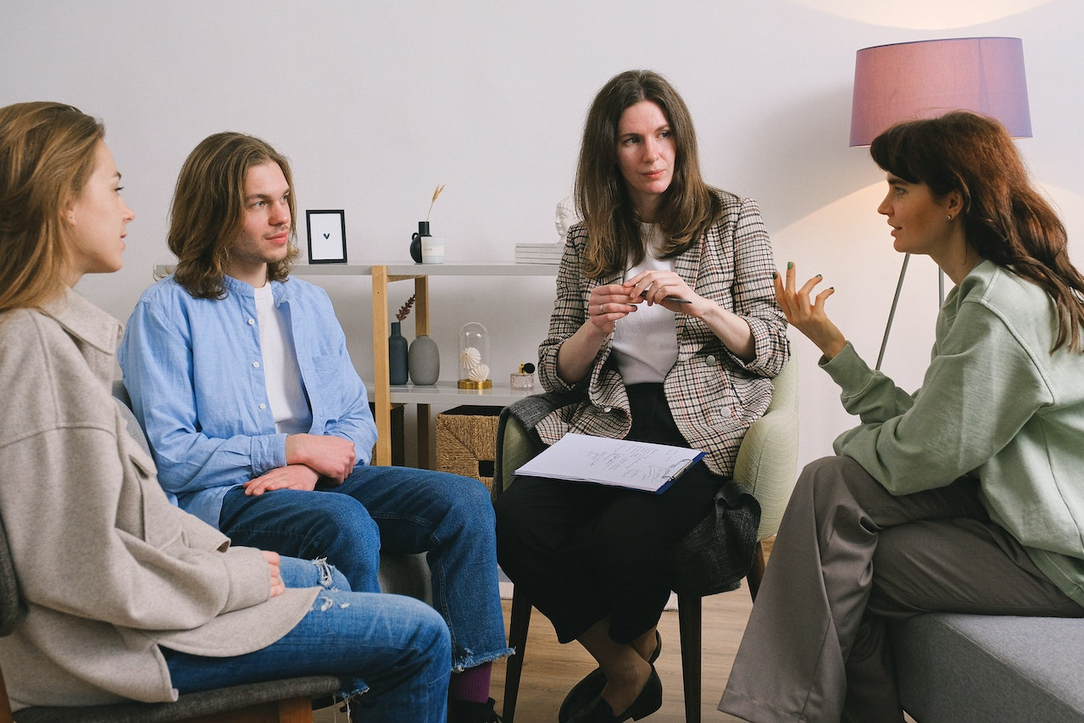
OBJECTIVES
MAIN OBJECTIVE
Identify the stress levels of an IT professional and reduce the stress that’s built up
SUB OBJECTIVES
Detect user’s stress level through facial expressions and emotions.
Detect user’s stress levels via keyboard dynamics.
Detect user’s stress levels via External Mouse.
Implementation of a computer-based stress relieving activities and recommendation system.

Slide 5
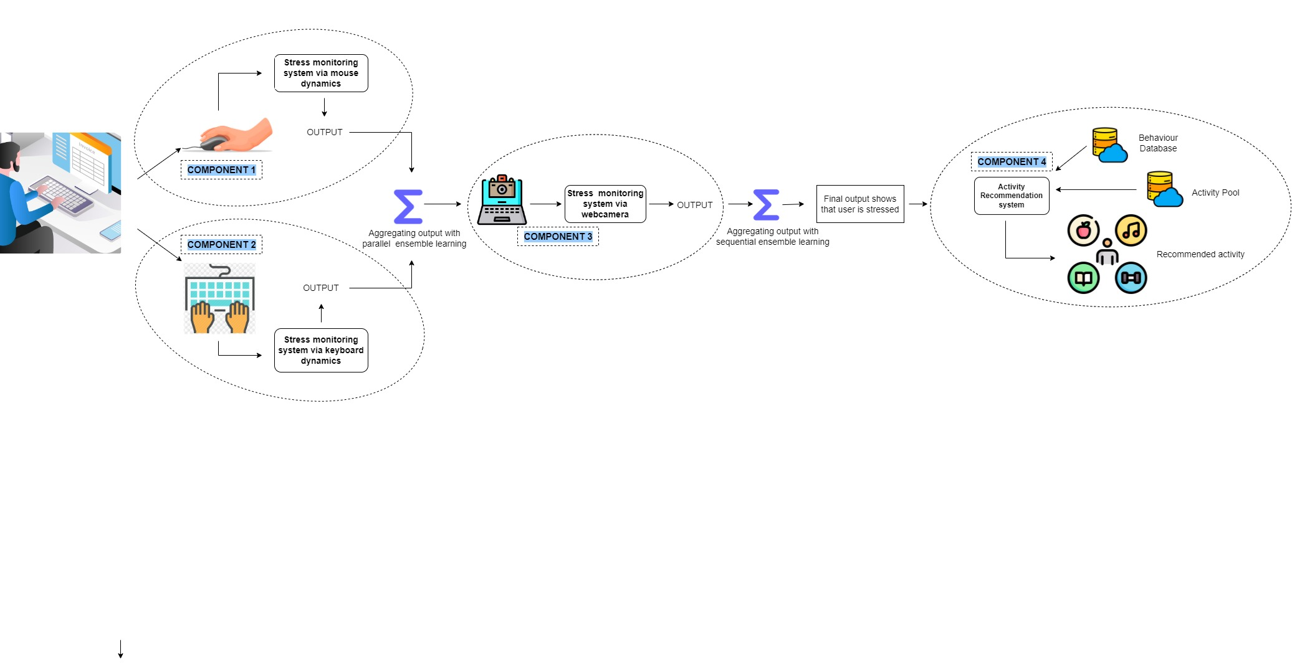
SYSTEM DIAGRAM
Aggregating outputs
Aggregating outputs

Slide 6
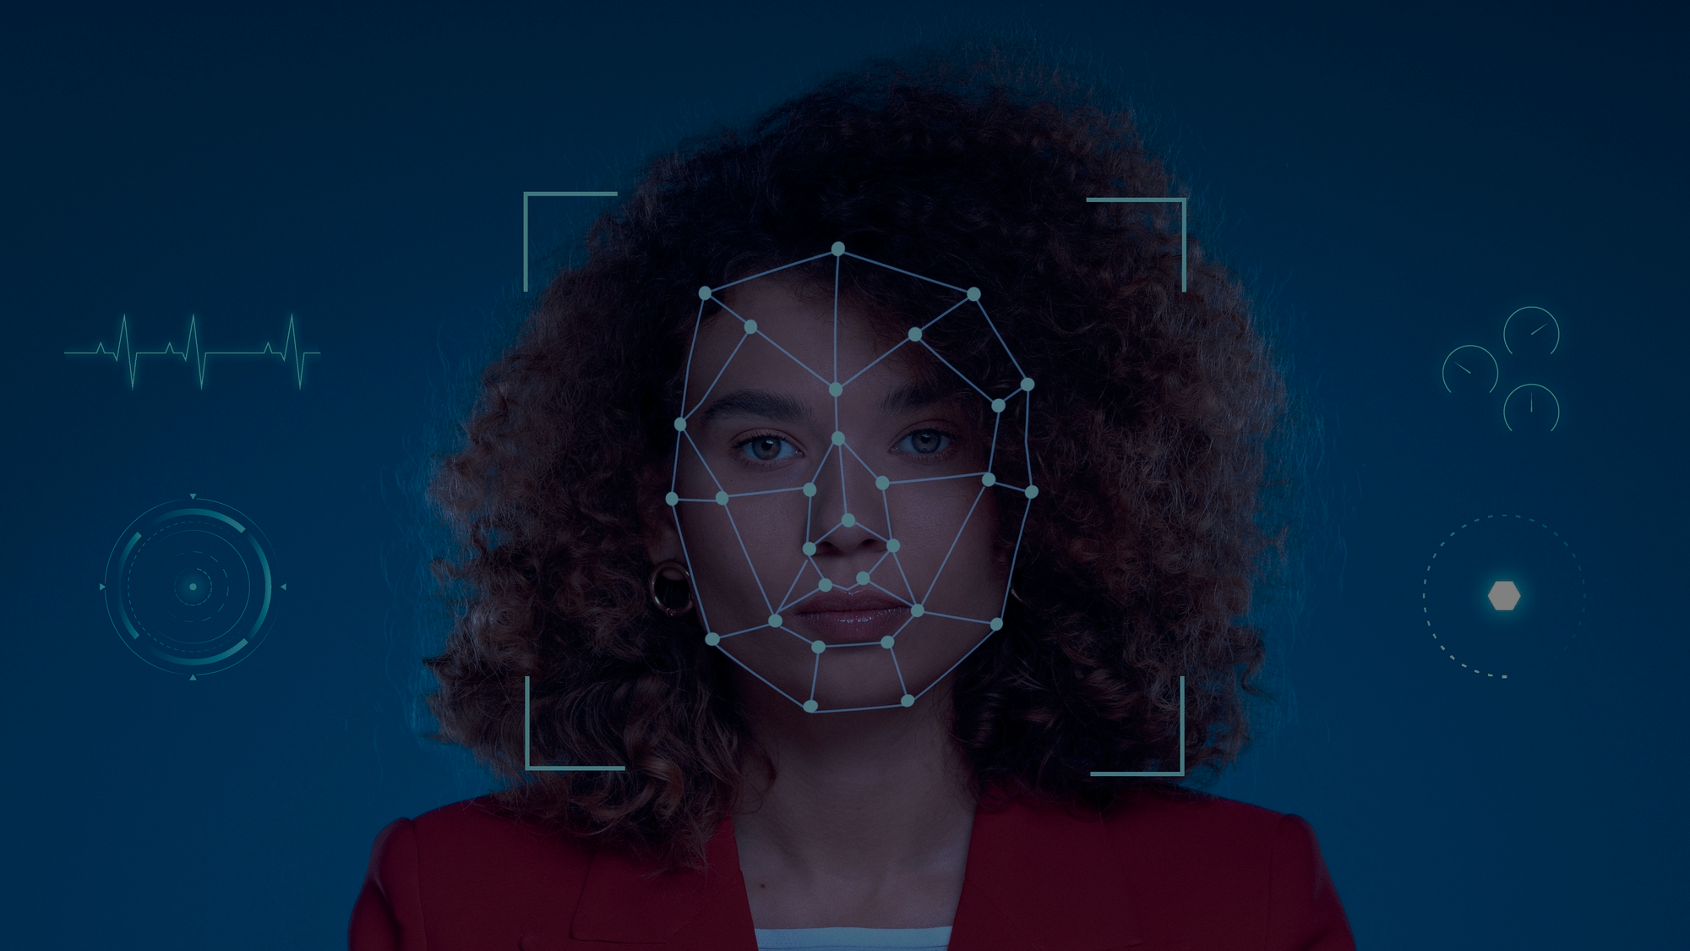
COMPONENT 1 : STRESS DETECTION VIA FACIAL DYNAMICS
Ranasinghe J. D – IT20037338
IT20037888 | RANASINGHE J.D. | TMP_2023_139

Slide 7
BACKGROUND
How to use facial dynamics as a measurement of stress?
What kind of data should be gathered?
What about already existing systems?
How is this component different from already existing research?
IT20037888 | RANASINGHE J.D. | TMP_2023_139

Slide 8
RESEARCH PROBLEM
Is facial dynamics accurate enough or should other factors be considered?
How to distinguishing various facial characteristics and interpret emotional states?
How to overcome variables such as illumination, shadows, facial position?
How to address the problem of overfitting in CNN?
IT20037888 | RANASINGHE J.D. | TMP_2023_139

Slide 9
OBJECTIVES
Specific Objective
To develop a machine learning algorithm for detecting stress from facial expressions using hierarchical attention mechanism.
Sub Objectives
Research on how to overcome overfitting in CNN.
Identify the different regions to use for selective focus.
Identify relevant facial expressions associated with stress (Furrowed brow, Tightened jaw).
Explore the correlation between age, gender and stress levels.
IT20037888 | RANASINGHE J.D. | TMP_2023_139

Slide 10
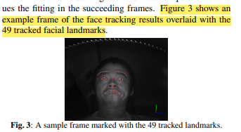
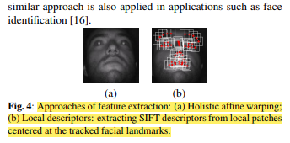
RESEARCH GAP
When discussing about the research gap in relation to this component,
In paper [1] they have used computer vision technologies where facial landmarks are incorporated for feature extraction, to detect the specific facial expressions.
IT20037888 | RANASINGHE J.D. | TMP_2023_139

Slide 11
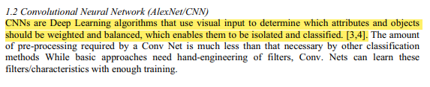
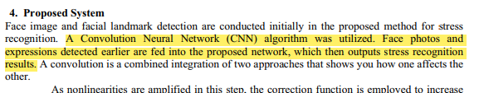
RESEARCH GAP
When discussing about the research gap in relation to this component,
In paper [2], they have used CNN models as a deep learning algorithm to classify the facial expressions to seven different classes.
IT20037888 | RANASINGHE J.D. | TMP_2023_139

Slide 12
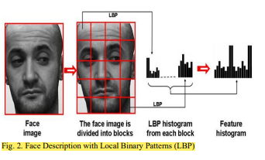
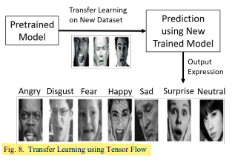
RESEARCH GAP
When discussing about the research gap in relation to this component,
In paper [3], they have used CNN models and feature histograms for feature extraction. Transfer learning has also been applied in this context.
IT20037888 | RANASINGHE J.D. | TMP_2023_139

Slide 13


RESEARCH GAP
 | Research A [1] | Research B [2] | Research C [3] | Proposed Solution
Usage of a hierarchical attention mechanism for selective focus
Addresses the problem of overfitting
Not solely focused on facial dynamics
Considers age and gender as factors that contributes to stress
Use of CNN models
Categorizes to emotion levels
Give a weight for the stress level for each emotion
IT20037888 | RANASINGHE J.D. | TMP_2023_139

Slide 14
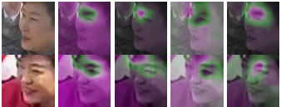
NOVELTY
Hierarchical attention mechanism for selective focus?
Use a hierarchical attention mechanism to selectively focus on different regions of the face based on their importance for the prediction of stress levels. [4]
IT20037888 | RANASINGHE J.D. | TMP_2023_139

Slide 15

NOVELTY
Hierarchical attention mechanism leads to overfitting. How to prevent this?
Overfitting: Attention mechanisms can lead to overfitting if they are not properly regularized. This is because attention weights can learn to focus on noisy or irrelevant features in the input, which can lead to poor generalization performance. [5]
IT20037888 | RANASINGHE J.D. | TMP_2023_139

Slide 16
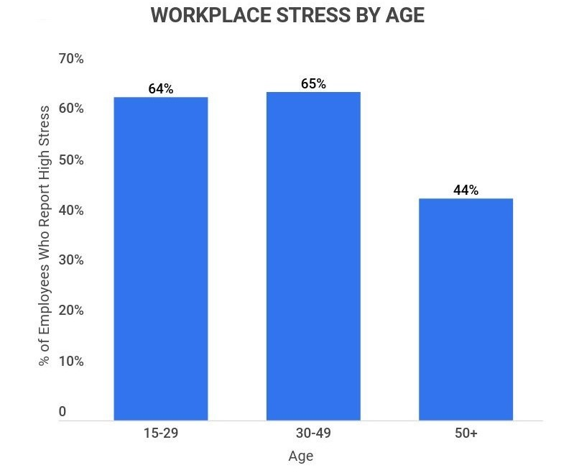
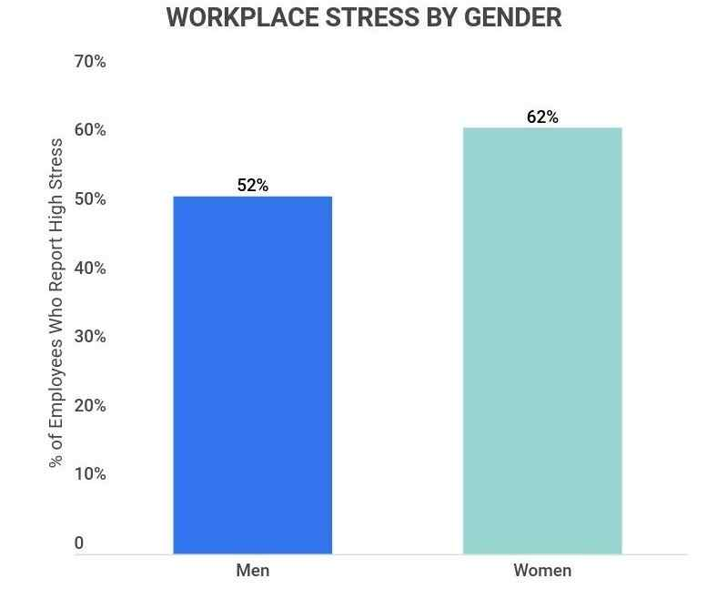
NOVELTY
Age and Gender contribute to stress levels?
IT20037888 | RANASINGHE J.D. | TMP_2023_139

Slide 17
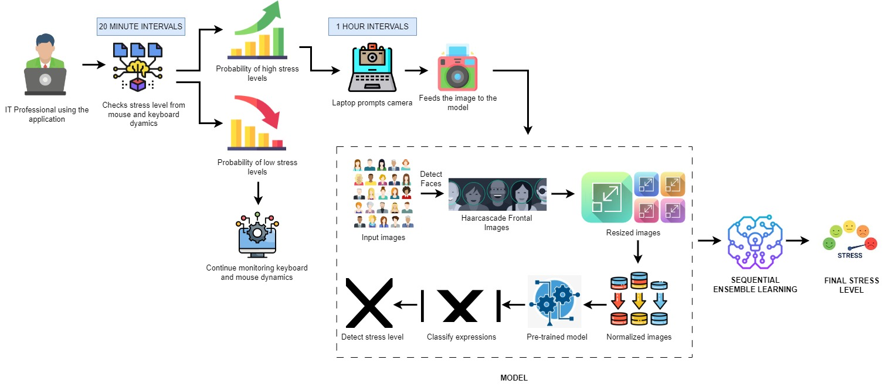
COMPONENT DIAGRAM
IT20037888 | RANASINGHE J.D. | TMP_2023_139

Slide 18









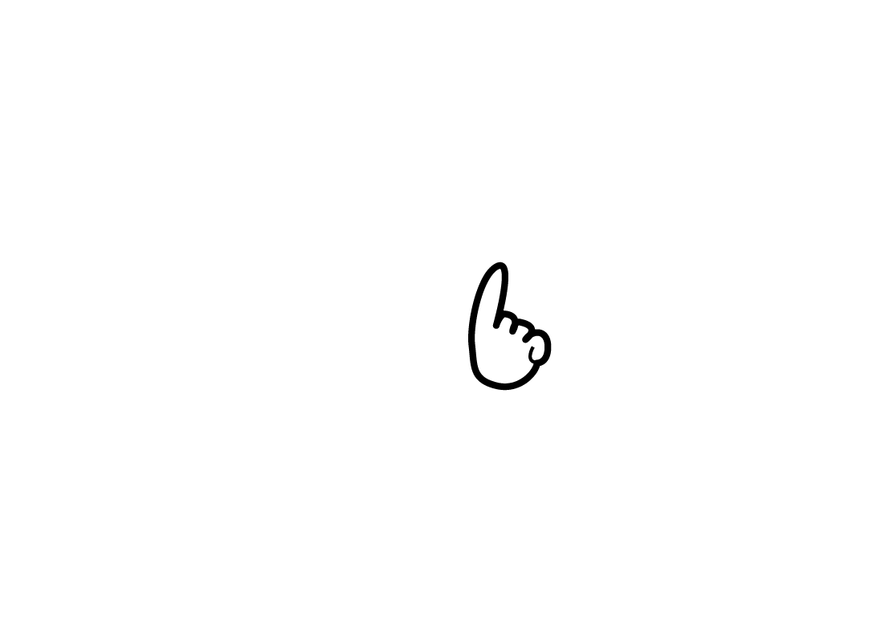
REQUIREMENTS
Functional Requirements
The component should be able to,
Non-Functional Requirements
The component should be able to,
IT20037888 | RANASINGHE J.D. | TMP_2023_139

Slide 19
REFERENCES
[1] H. Gao, A. Yüce, and J.-P. Thiran, “DETECTING EMOTIONAL STRESS FROM FACIAL EXPRESSIONS FOR DRIVING SAFETY.”
[2] R. P. Naidu, P. S. Sagar, K. Praveen, K. Kiran, and K. Khalandar, “Stress Recognition Using Facial Landmarks and Cnn (Alexnet),” in Journal of Physics: Conference Series, Nov. 2021, vol. 2089, no. 1. doi: 10.1088/1742-6596/2089/1/012039.
[3] Wan-Ting Chew, “Facial Expression Recognition Via Enhanced Stress Convolution Neural Network for Stress Detection.”
[4] Wang, Q. (2022). Face Recognition with Attention Mechanisms. https://researchrepository.wvu.edu/etd/11382
[5] Vaswani, A., Shazeer, N., Parmar, N., Uszkoreit, J., Jones, L., Gomez, A. N., Kaiser, L., & Polosukhin, I. (2017). Attention Is All You Need. http://arxiv.org/abs/1706.03762
IT20037888 | RANASINGHE J.D. | TMP_2023_139

Slide 20

COMPONENT 2 : STRESS RELIVING ACTIVITIES DEVELOPMENT AND RECOMMENDATION SYSTEM
Bartholomeusz S. V. – IT20274702
IT20274702 | BARTHOLOMEUSZ S.V.| TMP_2023_139

Slide 21
BACKGROUND
There are very few stress-relieving solutions available that provide personalized stress-relieving techniques specifically focused on IT professionals.
Many stress-relieving software solutions focus on using only one activity such as listening to music to relieve stress.
Similar solutions are compared in the next slides.
IT20274702 | BARTHOLOMEUSZ S.V.| TMP_2023_139

Slide 22
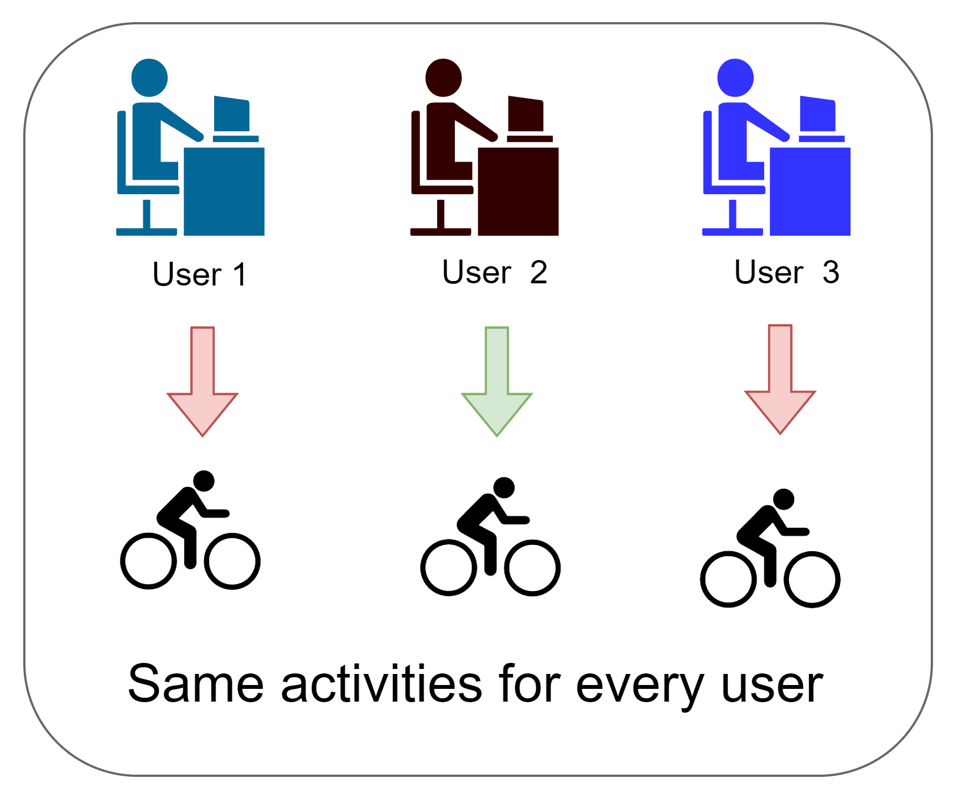
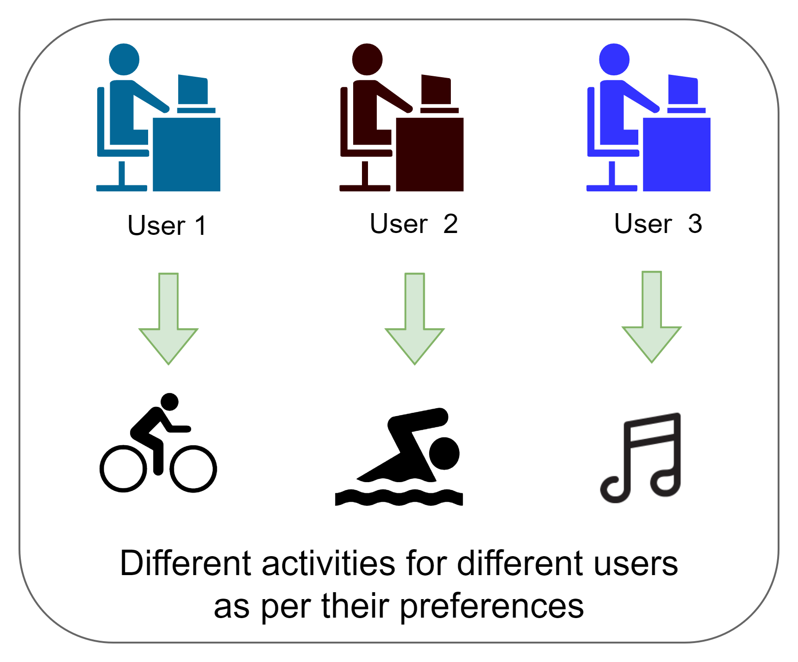
RESEARCH GAP
Mellow – A stress management is system developed by Chandrasiri et al., has a stress relieving activity recommendation system developed with a pre trained machine learning modal. User stress level and categories of books, poems details are the features used to train the modal. So, the model can identify the relevant relaxation sessions according to the user stress level [3].
Our recommendation system will be developed using reinforcement learning. Hence our recommendation system will learn the user and recommend activities as per their preferences and effectiveness towards activities.
Vs
Their solution
Our solution
IT20274702 | BARTHOLOMEUSZ S.V.| TMP_2023_139

Slide 23
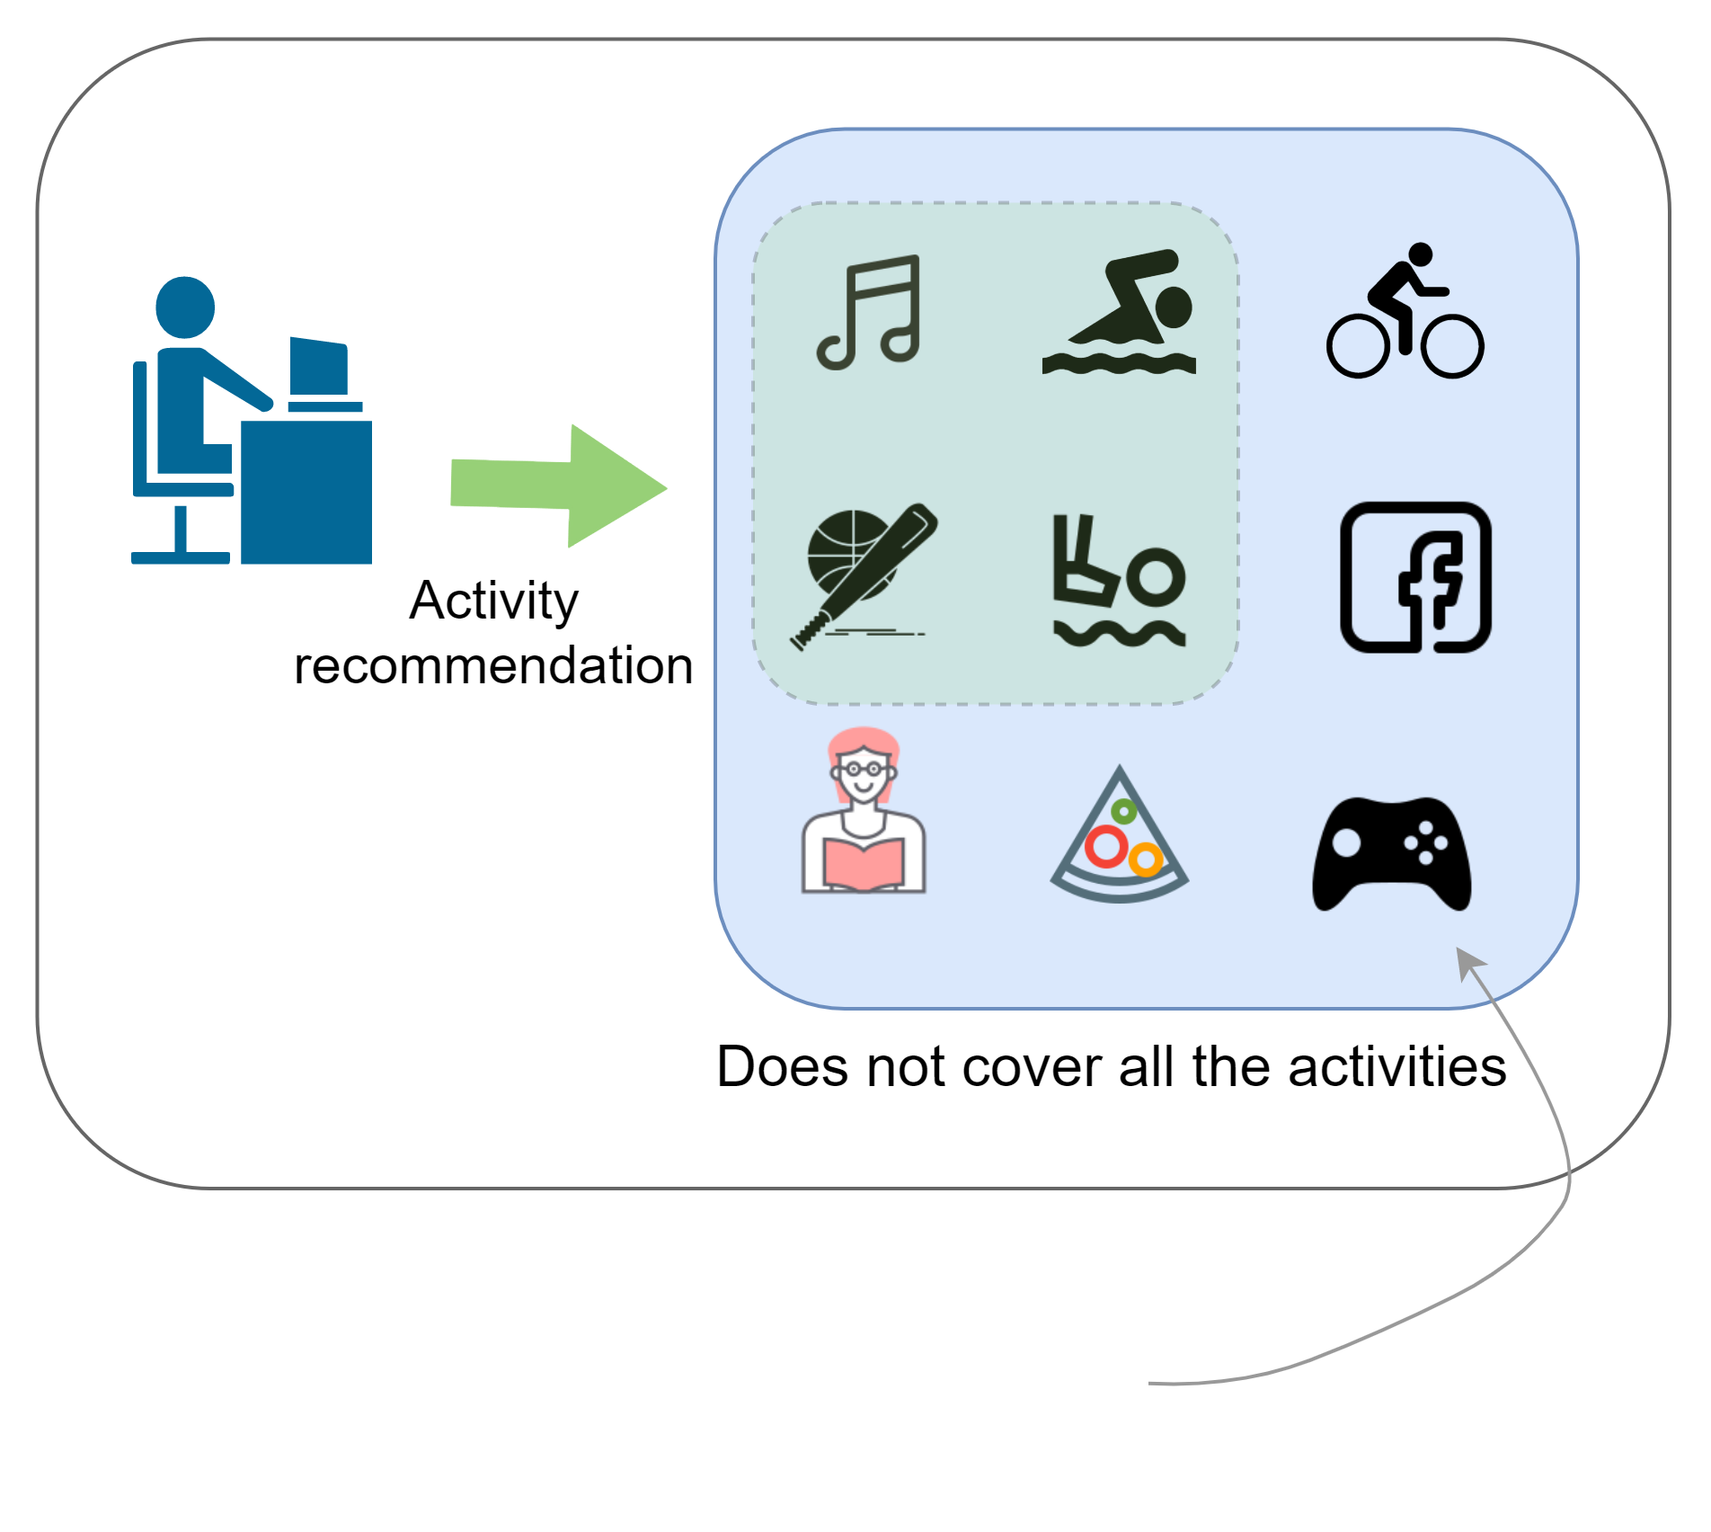
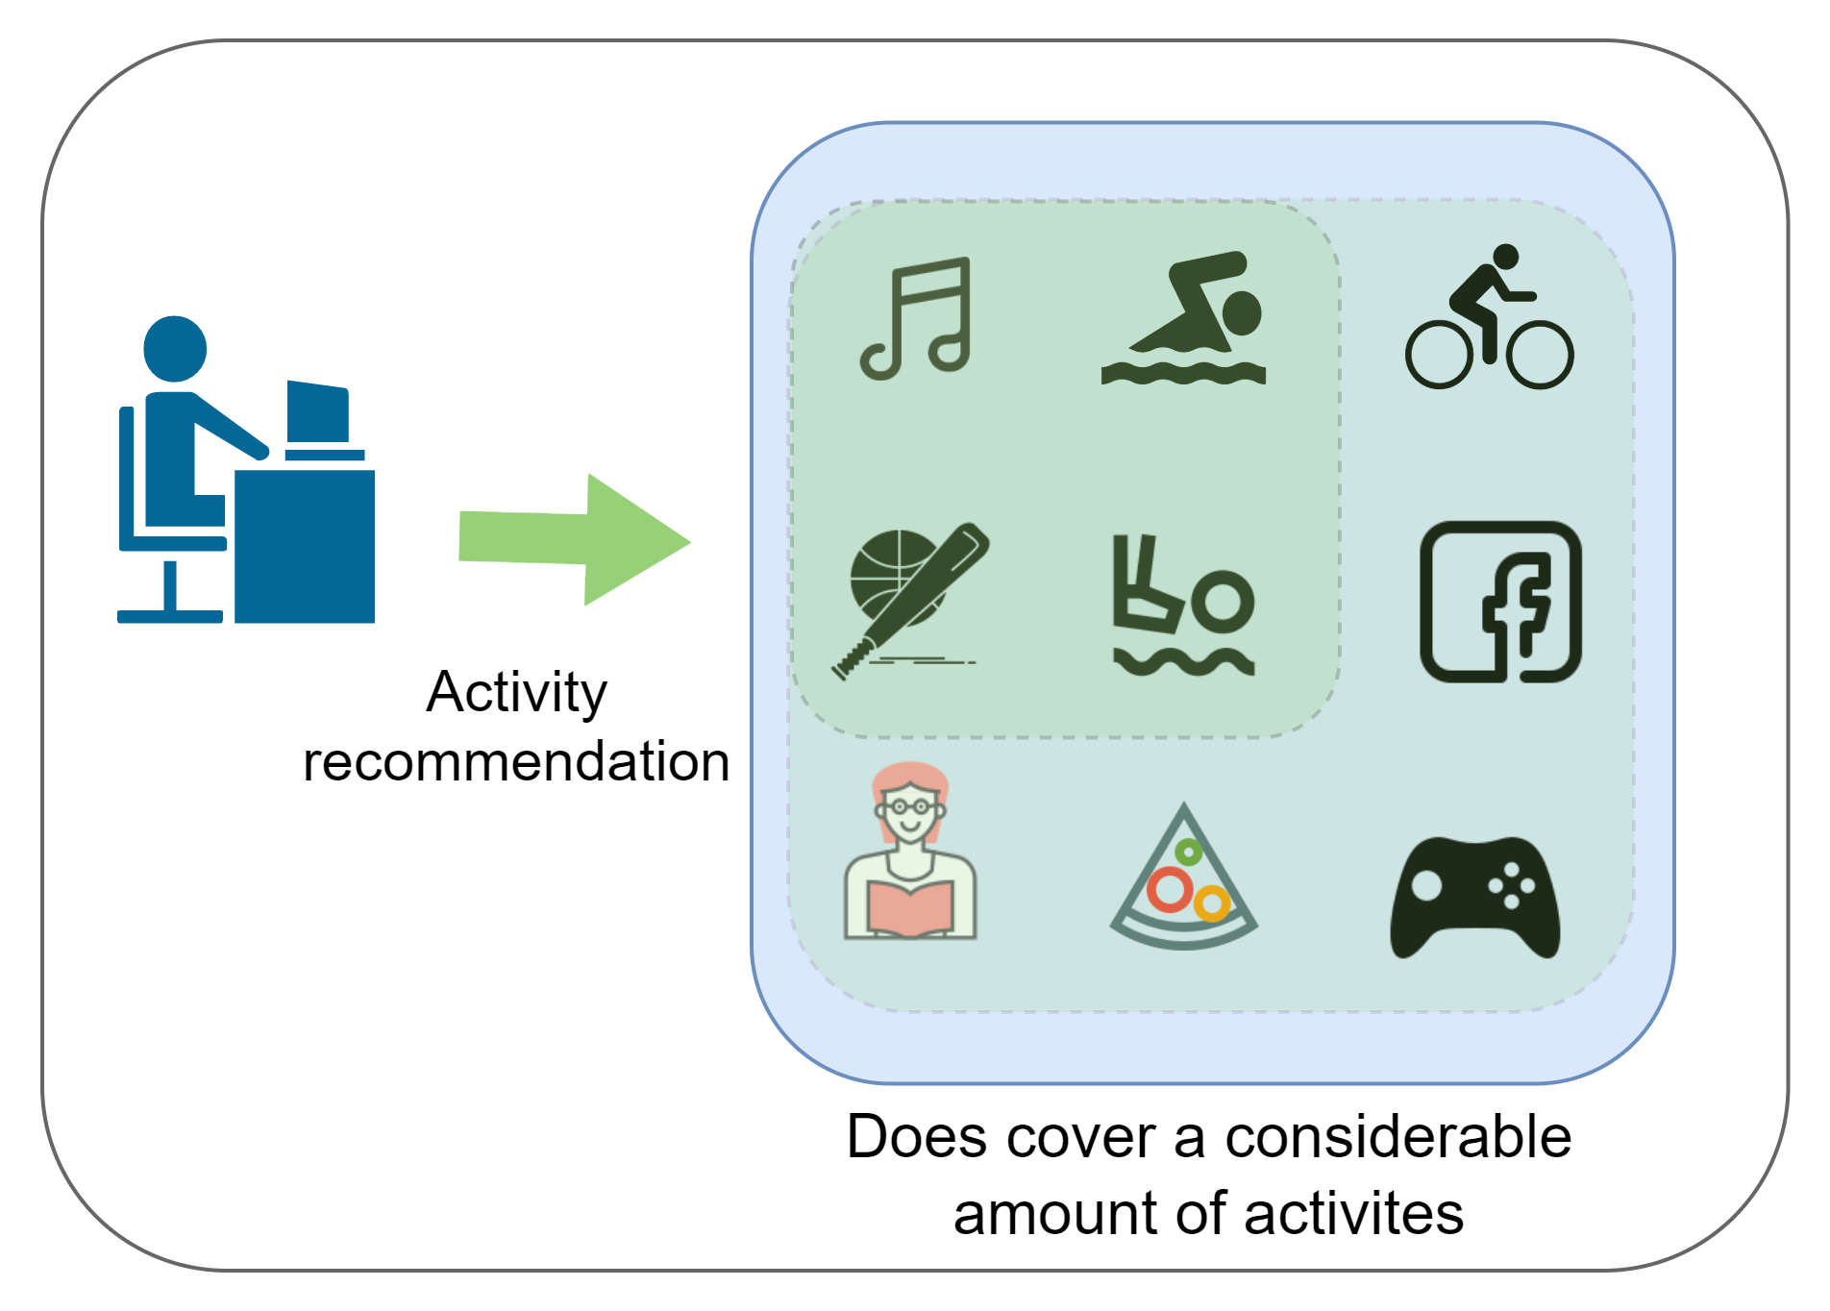
RESEARCH GAP
xīnlĭ – A social media app to replenish mental health developed by Kalansooriya et al., has an activity recommendation system developed using Q learning approach. Q learning always tries to go with the path which will give the maximum reward [4].
Our recommendation system is proposed to develop with SARSA method which will control the exploration and exploitation balance towards activities. Hence our recommendation system provides a better coverage of the activities while maintaining the personalization.
Vs
IT20274702 | BARTHOLOMEUSZ S.V.| TMP_2023_139

Slide 24
RESEARCH GAP
 | Research A [1] | Research B [2] | Research C [3] | Research D [4] | Proposed Solution
Various types of stress relieving activities are available
Activity recommendation
Recommendations are done in a personalized manner
Recommendation system adapts to environmental changes
Cold start problem is addressed
Echo chamber effect problem is addressed
Long tail effect problem is addressed
IT20274702 | BARTHOLOMEUSZ S.V.| TMP_2023_139

Slide 25
RESEARCH PROBLEM
How to develop a recommendation system which will be able to provide recommendations in a personalized manner?
How to develop a recommendation system which is capable of adapting future environmental changes?
How to develop a recommendation system which will be address cold start problem, echo chamber effect, long tail effect?
How to combine Q values from multiple Q tables?
How to develop the stress relieving activity pool?
IT20274702 | BARTHOLOMEUSZ S.V.| TMP_2023_139

Slide 26
NOVELTY
Maintaining 3 different types of Q tables and getting collective Q value to recommend the most suitable activity (action) at a given stress level simultaneously (state).
Apply a swarm-based optimization algorithm namely Whale optimization algorithm to identify weights (hyperparameter) for each Q table. [5]
Q_{total} = w₁ Q_{local} + w₂ Q_{global} + w₃ Q_{persona}
Why 3 Q tables?
To address cold start problem.
To improve personalization, without echo chamber effect problem.
IT20274702 | BARTHOLOMEUSZ S.V.| TMP_2023_139

Slide 27
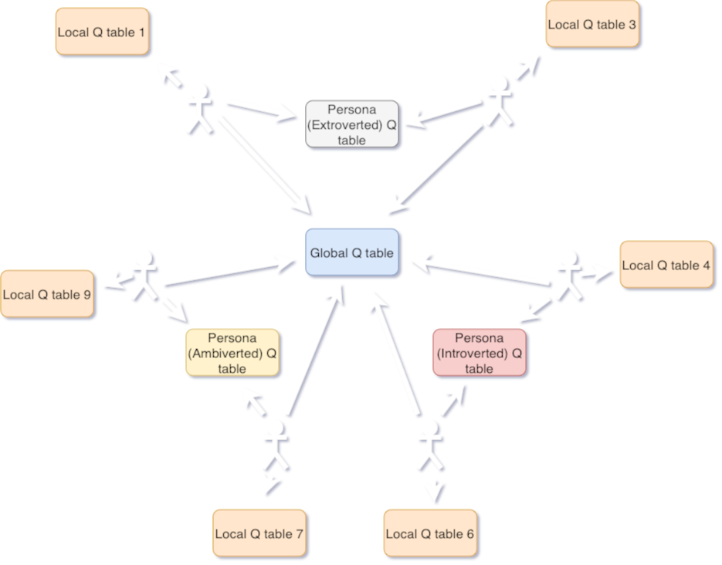
NOVELTY EXPLAINATION
In each episode, three Q tables will be updated.
If 200 users are interacting with the system in one episode,
global Q table will be updated for 200 times.
There are one local Q table per person, hence 200 local tables will be updated but a local Q table will be updated only once.
If there are three user categories, then three Persona Q tables will be maintained and updated for the number of users belonging to each respective category.

Slide 28
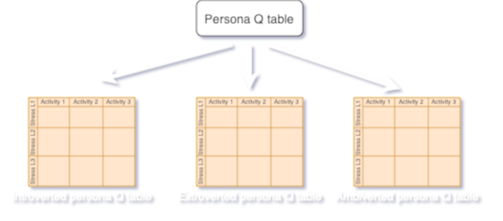
NOVELTY EXPLAINATION
Multiple Q tables each tailored to a specific user type, will be maintained.
Why? To address cold start problem
How? When the user first starts to use this system, they will be recommended more effective activities based on their personal types.

Slide 29
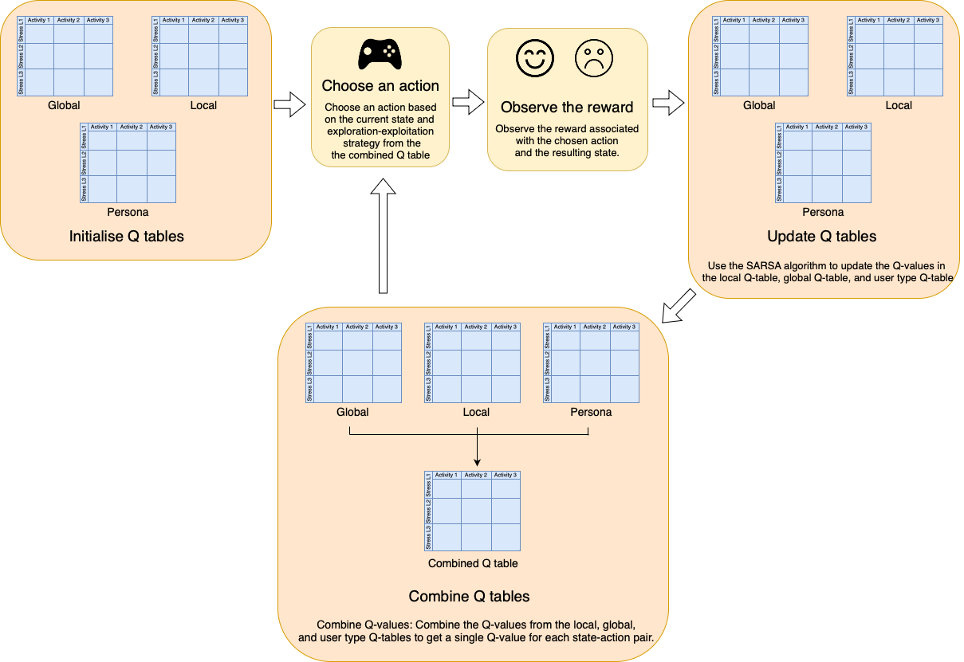
NOVELTY - EXPLAINATION

Slide 30
OBJECTIVES
Specific Objective
Develop a cross-platform desktop application which will has a recommendation for stress relieving activities.
Sub Objectives
Selecting and developing activities which are capable of relieving stress.
Develop a recommendation system to recommend stress relieving activities.
Develop a cross platform desktop application where IT professionals can perform recommended activities.

Slide 31
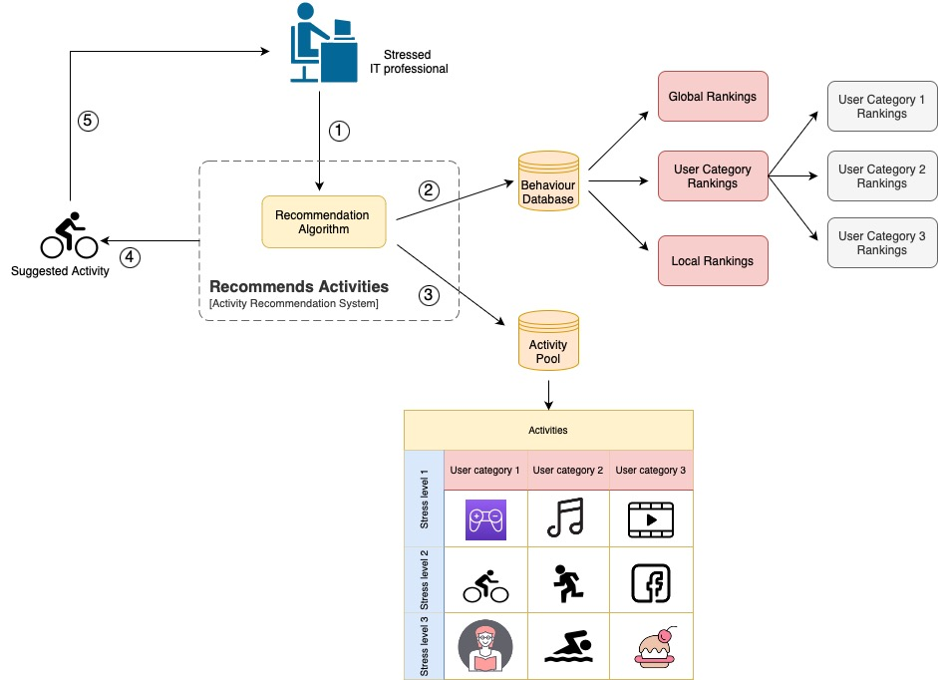
COMPONENT DIAGRAM
IT20274702 | BARTHOLOMEUSZ S.V.| TMP_2023_139

Slide 32









REQUIREMENTS
Functional Requirements
The component should be able to,
Non-Functional Requirements
The component should be able to,
IT20274702 | BARTHOLOMEUSZ S.V.| TMP_2023_139

Slide 33
REFERENCES
[1] - I. -h. Shin et al., "Automatic stress-relieving music recommendation system based on photoplethysmography-derived heart rate variability analysis," 2014 36th Annual International Conference of the IEEE Engineering in Medicine and Biology Society, Chicago, IL, USA, 2014, pp. 6402-6405, doi: 10.1109/EMBC.2014.6945093.
[2] - Kang, Ji-Soo, Dong-Hoon Shin, Ji-Won Baek, and Kyungyong Chung. 2019. "Activity Recommendation Model Using Rank Correlation for Chronic Stress Management" Applied Sciences 9, no. 20: 4284. https://doi.org/10.3390/app9204284
[3] - K. G. P. R. Chandrasiri, A. A. Chandrasena, L. H. C. R. De Silva, H. W. V. O. Jayasinghe, G. T. Dassanayake and O. Seneweera, "Mellow: Stress Management System For University Students In Sri Lanka," 2021 6th International Conference on Information Technology Research (ICITR), 2021, pp. 1-6, doi: 10.1109/ICITR54349.2021.9657419.
[4] - S. Kalansooriya, A. Kaluarachchi, C. Weerawickrama, D. Nanayakkara, D. Kasthurirathna and D. Adeepa, "“xīnlĭ” The Social Media App to Replenish Mental Health with the Aid of an Egocentric Network," 2022 IEEE 10th Region 10 Humanitarian Technology Conference (R10-HTC), Hyderabad, India, 2022, pp. 348-354, doi: 10.1109/R10-HTC54060.2022.9929642.
[5] – N. Ashraf, R. Mostafa, R. Sakr, M. Rashed, “Optimizing hyperparameters of deep reinforcement learning for autonomous driving based on whale optimization algorithm”, https://doi.org/10.1371/journal.pone.0252754
IT20274702 | BARTHOLOMEUSZ S.V.| TMP_2023_139

Slide 34
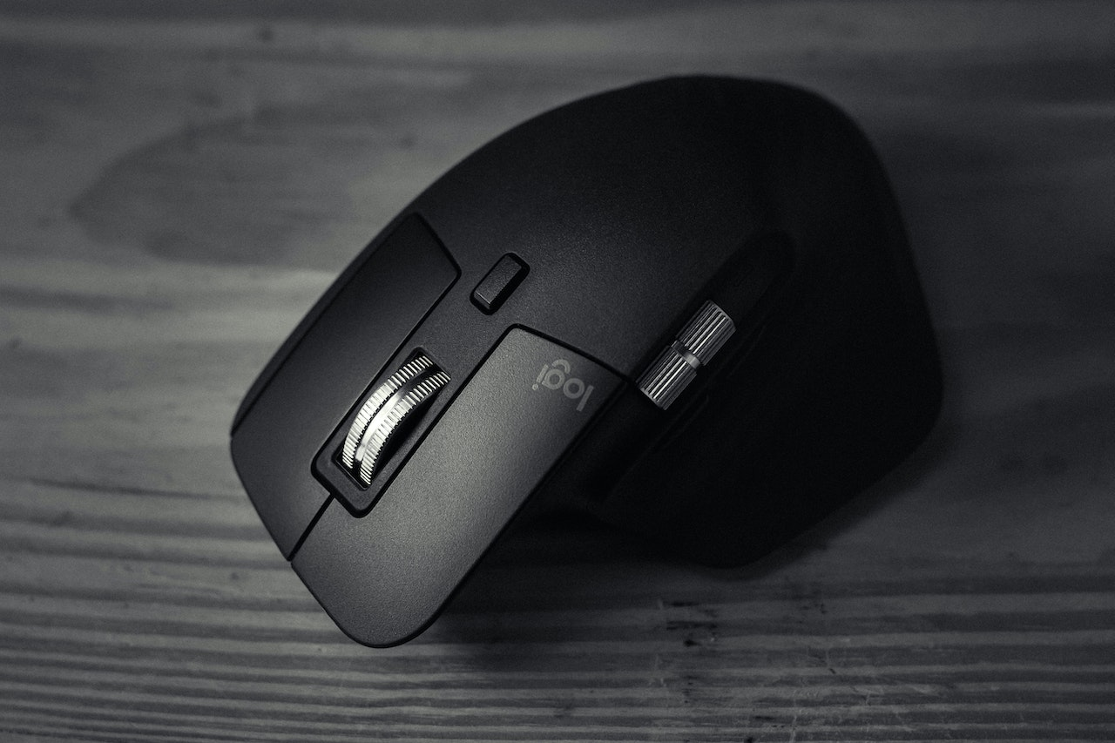
COMPONENT 3: STRESS DETECTION VIA EXTERNAL MOUSE
Jayathilake S. M. D. A. R. - IT20037338
IT20037338 | JAYATHILAKE S.M.D.A.R.| TMP_2023_139

Slide 35
BACKGROUND
Can we measure stress via an external mouse?
What kind of data should be gathered?
Mouse movements and clicks?
IT20037338 | JAYATHILAKE S.M.D.A.R.| TMP_2023_139

Slide 36
RESEARCH PROBLEM
Investigate the use of mouse click dynamics and movements to evaluate stress levels in IT professionals?
Mouse click data is complicated and diverse, involving characteristics such as speed, click length, and task type, which must be gathered and evaluated properly to offer useful insights regarding stress levels.
How to detect stress via mouse dynamics? What about security?
IT20037338 | JAYATHILAKE S.M.D.A.R.| TMP_2023_139

Slide 37
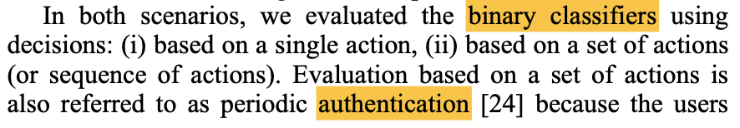
RESEARCH GAP
When discussing about the research gap in relation to this component,
In paper [1] they have mainly focused on intrusions, authorization and classification.
IT20037338 | JAYATHILAKE S.M.D.A.R.| TMP_2023_139

Slide 38
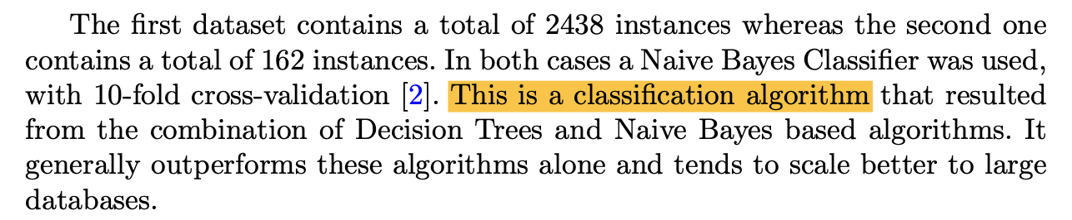
RESEARCH GAP
When discussing about the research gap in relation to this component,
In paper [2] they have mainly focused on classification algorithms.
IT20037338 | JAYATHILAKE S.M.D.A.R.| TMP_2023_139

Slide 39
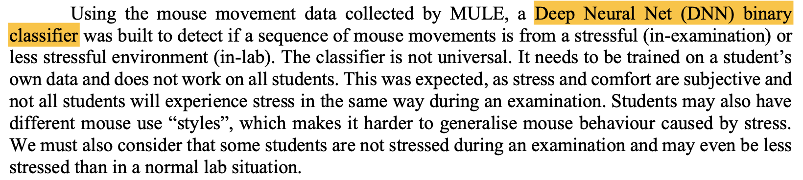
RESEARCH GAP
When discussing about the research gap in relation to this component,
In paper [3] also they have mainly focused on classification algorithm of Deep neural net binary classifier and modeling the data.
IT20037338 | JAYATHILAKE S.M.D.A.R.| TMP_2023_139

Slide 40
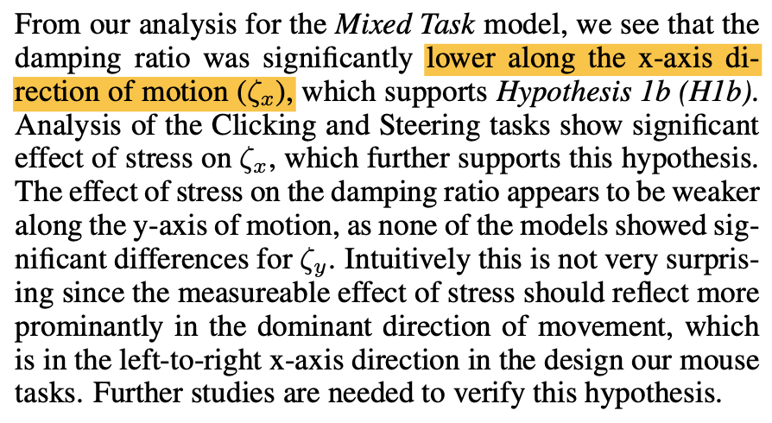
RESEARCH GAP
When discussing about the research gap in relation to this component,
In paper [4] also they have mainly focused on mouse motions.
IT20037338 | JAYATHILAKE S.M.D.A.R.| TMP_2023_139

Slide 41
RESEARCH GAP
 | Research A [1] | Research B [2] | Research C [3] | Research D [4] | Proposed Solution
Focused on data classifications
Personalized stress monitoring
Data encrypted using steganography
Focused on only Job/Work
Tracking both mouse movements and dynamics same time
Real time stress monitoring
IT20037338 | JAYATHILAKE S.M.D.A.R.| TMP_2023_139

Slide 42

NOVELTY
Encrypted Dataset
How to secure a user’s mouse dynamics?
Usage of steganography?
Secure data before model generation?
Feed encrypted data to the model?
What kind of model to use?
Modeling through CNN
IT20037338 | JAYATHILAKE S.M.D.A.R.| TMP_2023_139

Slide 43
OBJECTIVES
Specific Objective
The main goal of this research is to create a comprehensive framework for reliably tracking and evaluating mouse click dynamics and movements in order to get insights regarding developer stress levels while providing security to the data.
Sub Objectives
Hide text within an image using steganography technique.
Develop the model using encrypted images.
Feed encrypted images into the CNN model and obtain the outputs.
IT20037338 | JAYATHILAKE S.M.D.A.R.| TMP_2023_139

Slide 44
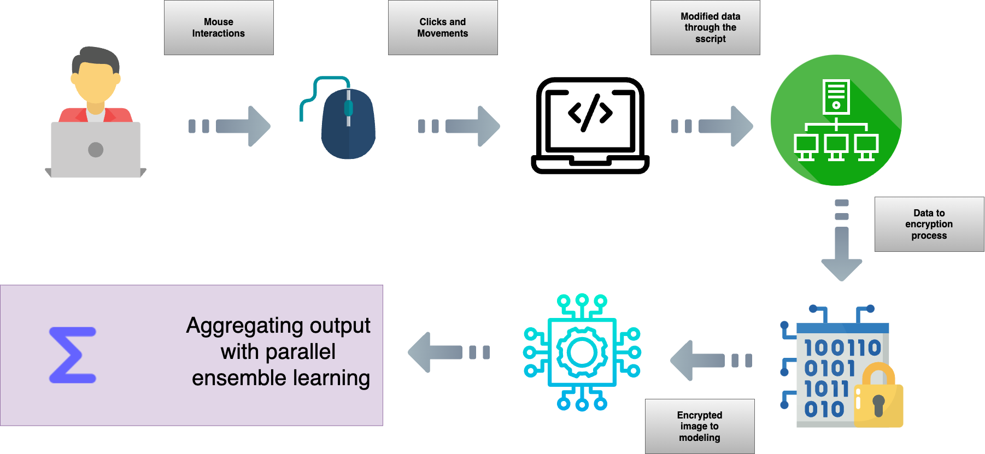
COMPONENT DIAGRAM
ASK DULSHAN
IT20037338 | JAYATHILAKE S.M.D.A.R.| TMP_2023_139

Slide 45




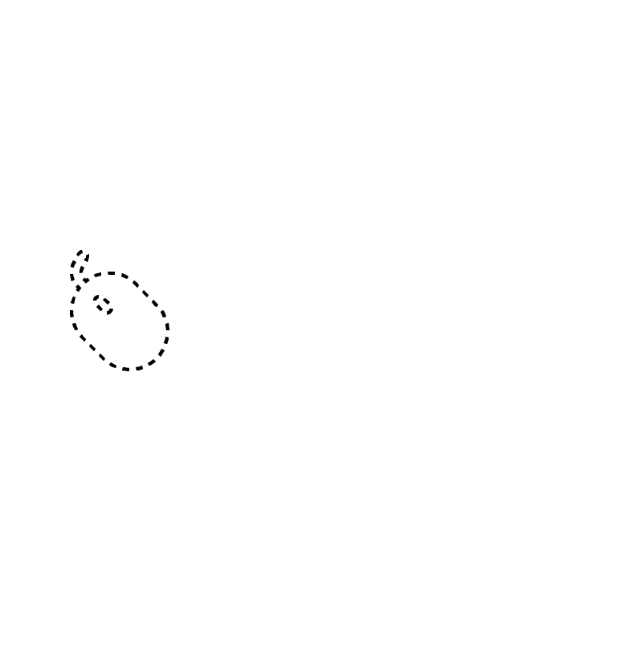



REQUIREMENTS
Functional Requirements
The component should be able to,
Non-Functional Requirements
The component should,
IT20037338 | JAYATHILAKE S.M.D.A.R.| TMP_2023_139

Slide 46
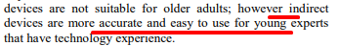
TRACKPAD USERS
What about trackpad users?
Do IT professionals use trackpads?
How do we cater these users?
IT20037338 | JAYATHILAKE S.M.D.A.R.| TMP_2023_139

Slide 47
REFERENCES
[1] - M. Antal, "Intrusion detection using mouse dynamics," Intrusion detection using mouse dynamics , p. 10, 2019.
[2] - N. Culligan, "What the Mouse Said: How Mouse Movements Can Relate to Student Stress and Success," What the Mouse Said: How Mouse Movements Can Relate to Student Stress and Success , p. 10, 2020.
[3] - C. Davide, N. Paulo, M. P. Jos´e, S. Nuno and N. Jos´e, "Using Mouse Dynamics to Assess Stress During Online Exams," Using Mouse Dynamics to Assess Stress During Online Exams, p. 15, 2015.
[4] - Ibrar Hussain, Iftikhar Ahmed Khan,Imran Ali Khan, Syed Sajid Hussain and Attiqa Rehman, "A SURVEY ON USAGE OF TOUCHSCREEN VERSUS MOUSE FOR INTERACTION”, p. 6, 2017.
IT20037338 | JAYATHILAKE S.M.D.A.R.| TMP_2023_139

Slide 48

COMPONENT 4: STRESS DETECTION VIA KEYSTROKE DYNAMICS
Perera M. S. D. – IT20020262
IT20020262 | PERERA M.S.D.| TMP_2023_139

Slide 49
BACKGROUND
Can we measure stress via a keyboard?
How to gather data?
Which data should be focused more?
Is it accurate?
IT20020262 | PERERA M.S.D.| TMP_2023_139

Slide 50
RESEARCH PROBLEM
Working on computers for an extended period of time may have negative effects towards an individual’s health.
What if there was a way to detect the users’ stress levels via the use of simple equipment such as a keyboard?
How to detect stress via keystroke dynamics?
What factors of keystroke dynamics may vary when the user is stressed ?
IT20020262 | PERERA M.S.D.| TMP_2023_139

Slide 51
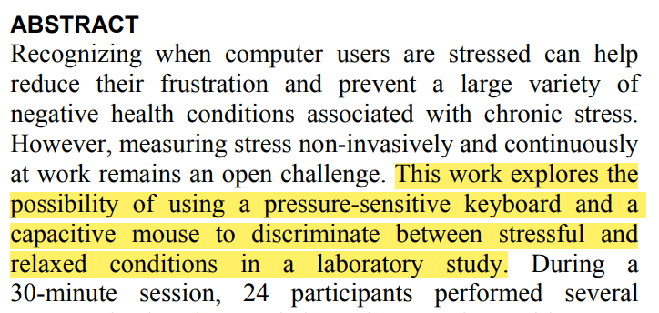
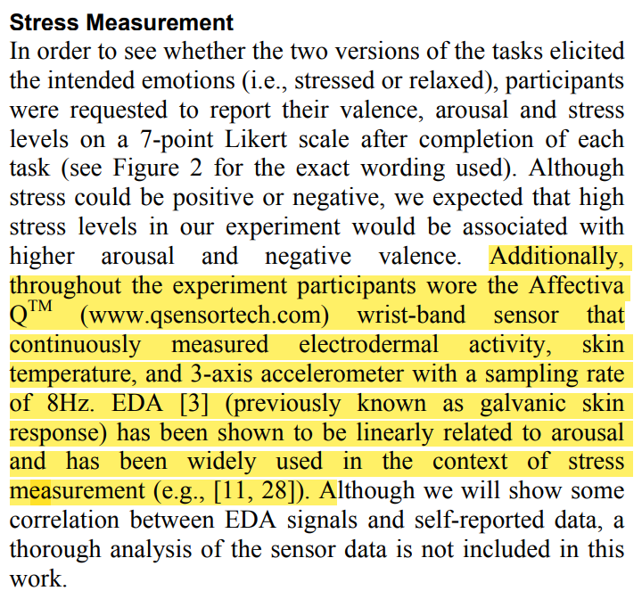
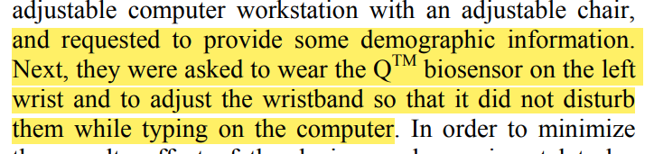
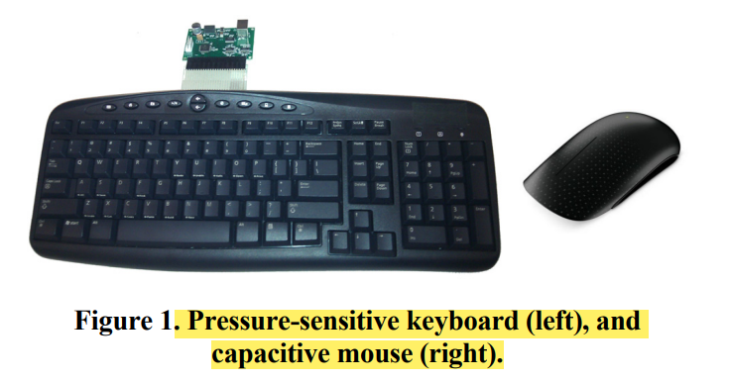
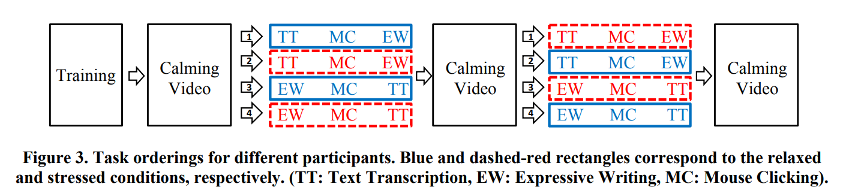
RESEARCH GAP
When discussing about the research gap in relation to this component,
In paper [1] they have used pressure a sensitive keyboard and a capacitate mouse as well as a bio-sensor to measure stress
IT20020262 | PERERA M.S.D.| TMP_2023_139

Slide 52
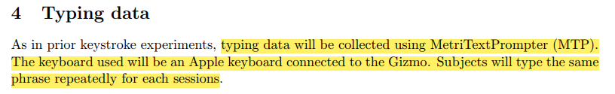
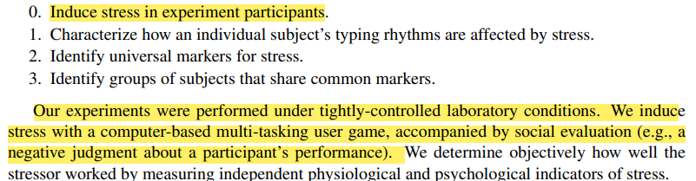
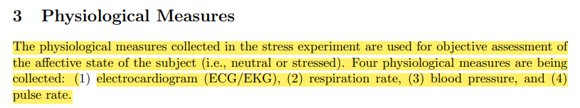
RESEARCH GAP
When discussing about the research gap in relation to this component,
In paper [2] they have used artificial stress induction activities, performed experiments in tightly controlled environments, utilized physiological equipment to monitor blood pressure, respiration rate, etc.… and also have used an Apple keyboard to get acquire the keystroke data.
IT20020262 | PERERA M.S.D.| TMP_2023_139

Slide 53
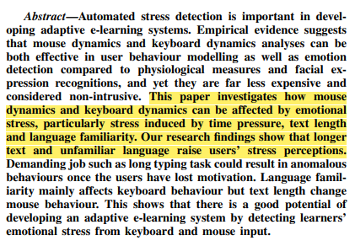
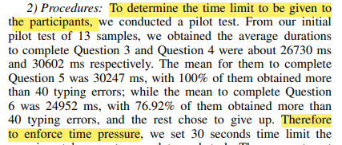
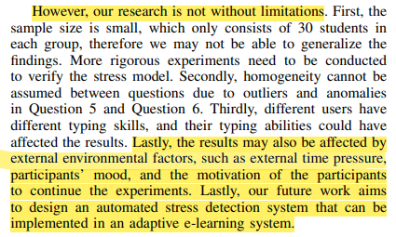
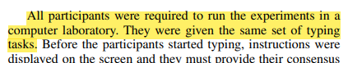

RESEARCH GAP
When discussing about the research gap in relation to this component,
In paper [3] they have used text lengths, language unfamiliarity, time pressure stress induction activities, and controlled equipment usage and in controlled laboratory environments during their experiments in their research.
IT20020262 | PERERA M.S.D.| TMP_2023_139

Slide 54




RESEARCH GAP
When discussing about the research gap in relation to this component,
In paper [4] have used pressure sensitive keyboards and keypress pressure, detected emotions of users, induced stress artificially and also in controlled environments where the users are instructed on what to do.
IT20020262 | PERERA M.S.D.| TMP_2023_139

Slide 55



RESEARCH GAP
When discussing about the research gap in relation to this component,
In paper [5] they have used artificial stress induction, typing patterns, behavioral patterns.
IT20020262 | PERERA M.S.D.| TMP_2023_139

Slide 56
RESEARCH GAP
 | Research A [1] | Research B [2] | Research C [3] | Research D [4] | Research E [5] | Proposed Solution
Special keyboard not required for system.
Biosensors/ Physiological equipment is not needed.
Build a function out of the typing speed variation patterns of users and utilize it
No artificial stress induction activities involved.
System can extend to everyday usage.
IT20020262 | PERERA M.S.D.| TMP_2023_139

Slide 57
NOVELTY
The novelty that this component proposes as opposed to the current research that has been conducted is that,
It does not require a keyboard with special capabilities. (Pressure sensitive keyboards).
It will be utilizing a custom-made script to gather keystroke dynamic data,
Keypress Latency
Typing Accuracy Rate
Typing Speed Variation
Will be identifying and analyzing the typing speed variation patterns of the users and build up a function out of the derived information which can later be used as a support in stress detection of the users.
It will not be utilizing any bio-sensors or psychological equipment to support the measurement of stress levels of the users.
It will not incorporate any artificial stress induction activities in order to induce stress in users.
Backspace
Delete
Identify and analyze patterns in variations
from any keyboard the user is using and prepare a customized dataset and feed to the trained machine learning model to generate stress level predictions.
IT20020262 | PERERA M.S.D.| TMP_2023_139

Slide 58
OBJECTIVES
SPECIFIC OBJECTIVE
Detect the current users stress level via the keystroke dynamics.
SUB OBJECTIVES
Train a machine learning model using the downloaded dataset[6].
Develop a script/program to monitor the current keystroke related data.
Modify the script to filter keypress latency, typing accuracy rate, typing speed
variations related data.
Identify and analyze typing speed variation patterns and build up a function from the derived information which can be utilized in stress detection in the long run.
Prepare the gathered data to support the format of the model.
Monitor the stress levels generated in 20-minute cycles.
IT20020262 | PERERA M.S.D.| TMP_2023_139

Slide 59

COMPONENT DIAGRAM
IT20020262 | PERERA M.S.D.| TMP_2023_139

Slide 60









REQUIREMENTS
FUNCTIONAL REQUIREMENTS
The component should be able to,
NON-FUNCTIONAL REQUIREMENTS
The component should,
IT20020262 | PERERA M.S.D.| TMP_2023_139

Slide 61
REFERENCES
[1] | P. P. A. R. M. C. Javier Hernandez, "Under Pressure: Sensing Stress of Computer Users," p. 10, 2014.
[2] | S.-H. LAU, "STRESS DETECTION FOR KEYSTROKE DYNAMICS," p. 232, 2018.
[3] | A. M. S. Yee Mei Lim, "Detecting Emotional Stress during Typing Task with," p. 10, 2014.
[4] | Z.-L. L. W.-J. Y. J. D. Hai-Rong LV, "EMOTION RECOGNITION BASED ON PRESSURE SENSOR KEYBOARDS," IEEE, p. 4, 2008.
[5] | L. M. Vizer, "Detecting Cognitive and Physical Stress Through Typing Behavior," p. 4, 2009.
[6] | C. WEERASINGHE, "Stress Detection by Keystroke,App & Mouse Changes," [Online]. Available: https://www.kaggle.com/datasets/chaminduweerasinghe/stress-detection-by-keystrokeapp-mouse-changes.
IT20020262 | PERERA M.S.D.| TMP_2023_139

Slide 62

TECHNOLOGIES
Python
Tensor flow / Open CV
Github
Azure / AWS
ElectronJS
Encryption Tools

Slide 63

COMMERCIALIZATION
Phase 1 – Launching the first version of the software and installing it at Xinotech Technology and services company.
Phase 2 – We are launching a free version of our software with a limited number of activities, and a professional version with unlocked full features that require a subscription. Our target clients are IT/Software companies who will benefit from the advanced capabilities of the pro version.

Slide 64

GANTT CHART

Slide 65

WORK BREAKDOWN STRUCTURE

Slide 66

THANK YOU!

